Slide 1

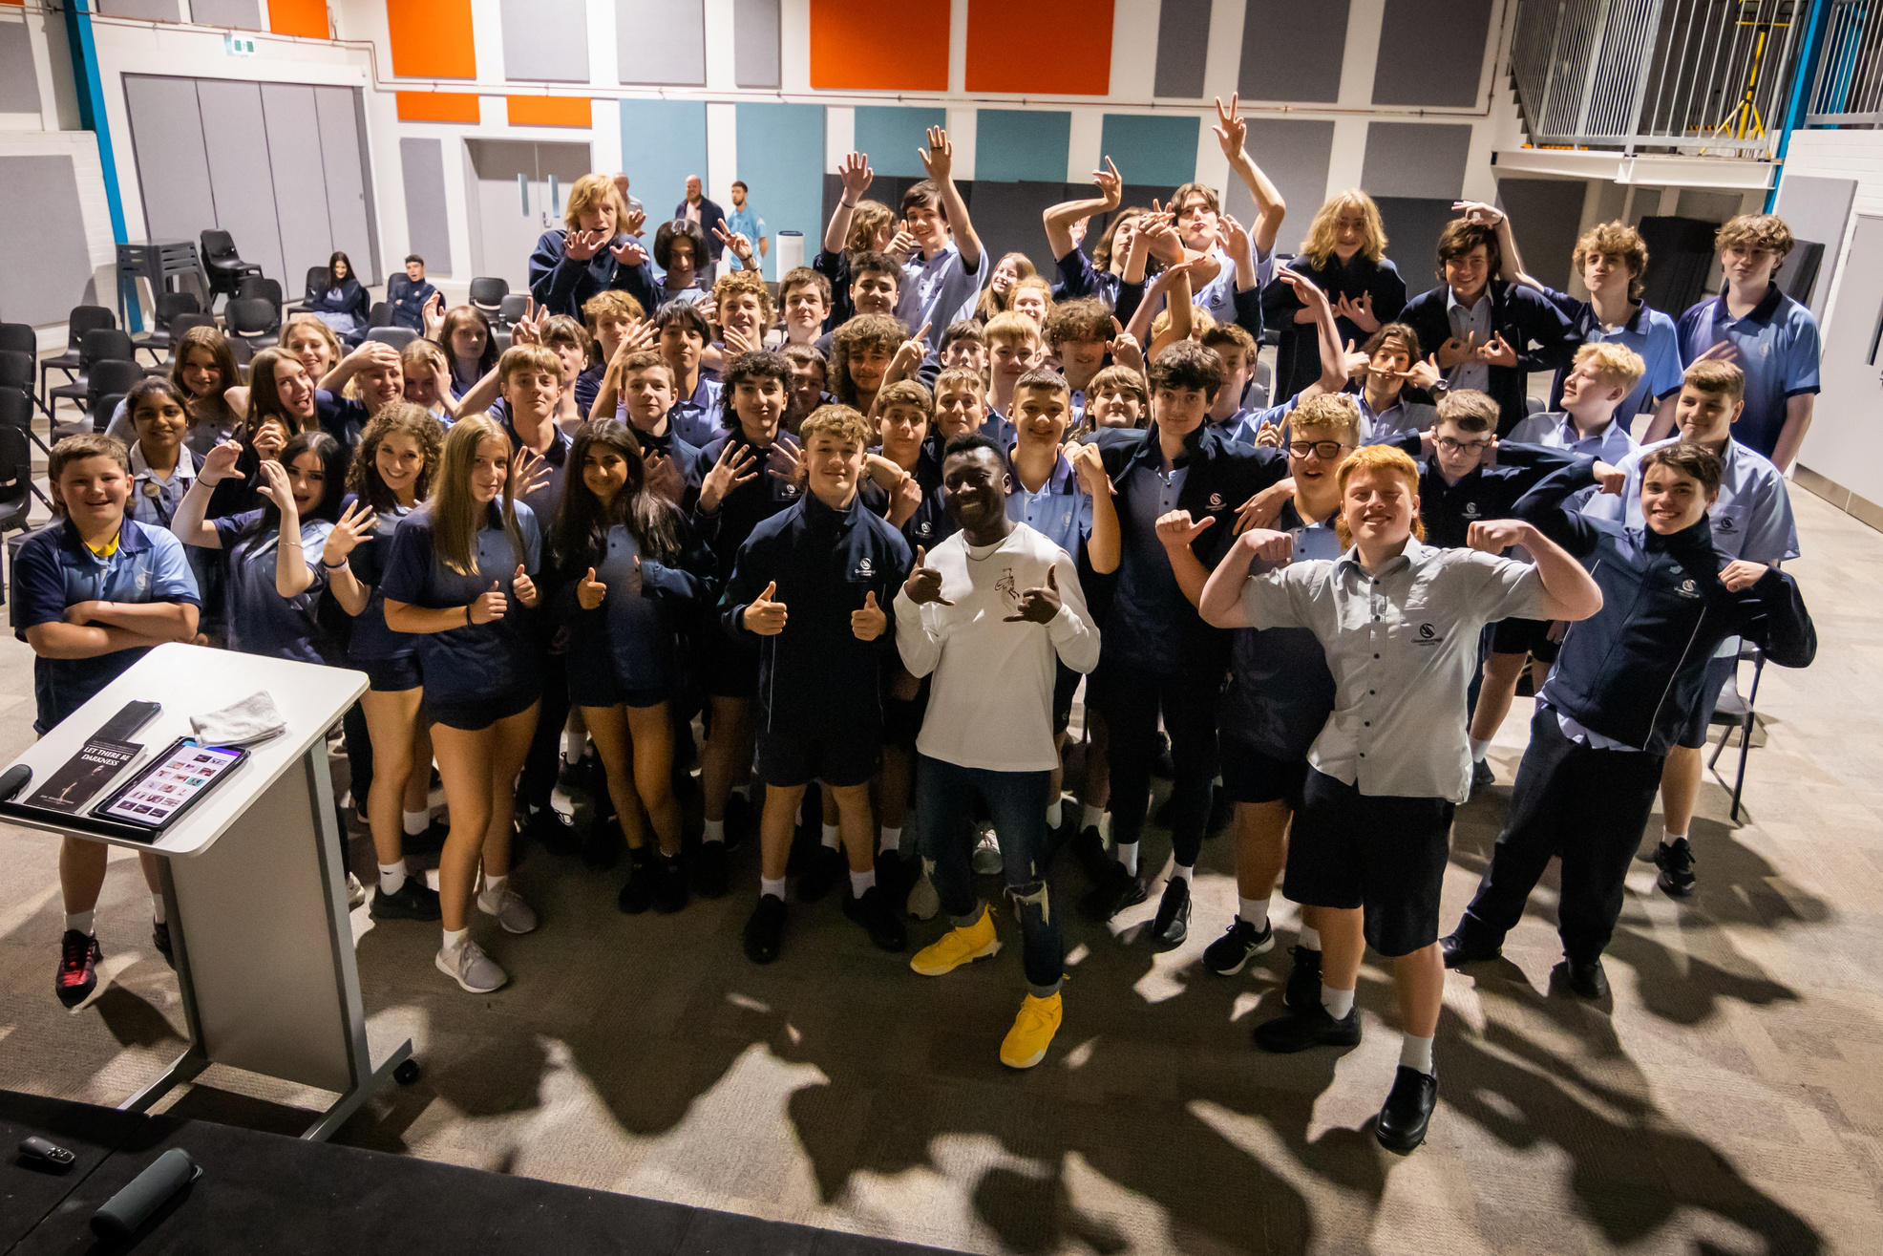

Eric
Agyeman
CREATING A SCHOOL CULTURE OF KINDNESS
Notes:
These slides are designed to introduce Eric & some of the key themes and topics he will be covering in his upcoming visit to your school.
This will help ensure the students are ready to engage and benefit fully from his message.

Slide 2



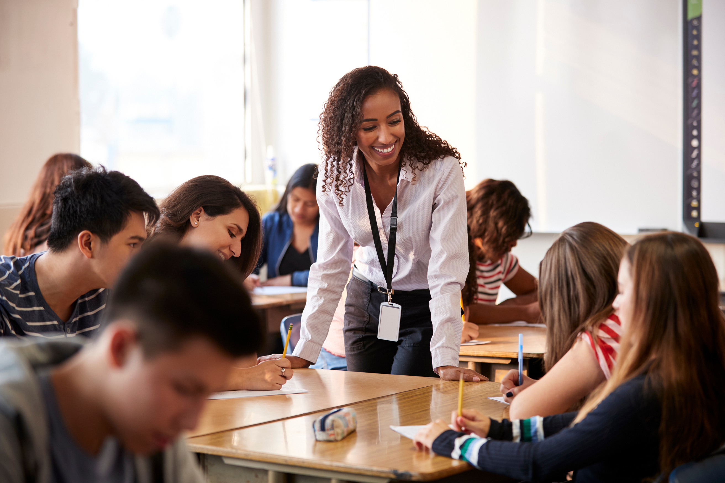


TEACHER LED
PRE- SESSION ACTIVITY
Notes:
To help your students get the most out of Eric's upcoming presentation, please guide them through the following slides.

Slide 3

01.
KINDNESS
DEFINING
THE TERMS
02.
UPSTANDERS
In small groups discuss and write down what these three terms mean to you.
03.
BELONGING
Notes:
- In small groups of 6-10, get the students discuss and write down what these three terms mean to them.
- Time dependant, you may want to assign one point per group. More than one group can brainstorm the same point

Slide 4
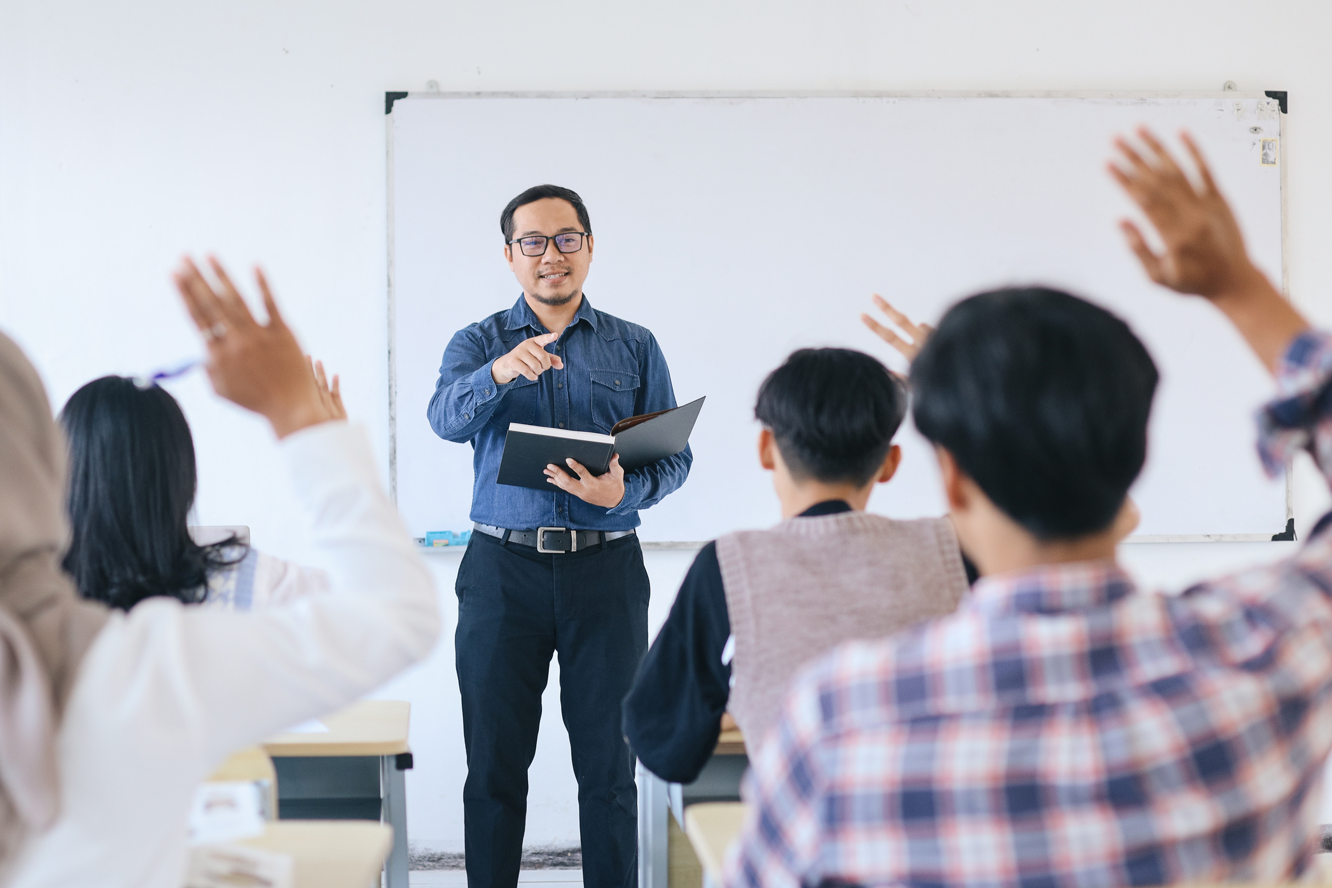
Let’s SHARE
Notes:
- Get each group to share to the rest of the class
- Time dependant, you may just get them to share one point

Slide 5
STORIES ARE POWERFUL...
Write down and share a story of how you have
been positively impacted by one or all of the terms
(Kindness, Upstanders, Belonging)
Notes:
- Get the students to do this individually
- Encourage a few students to share with the class

Slide 6
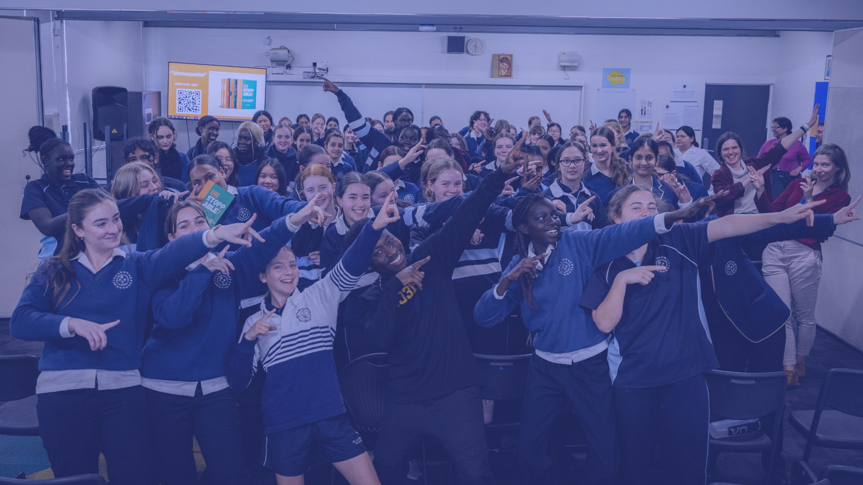
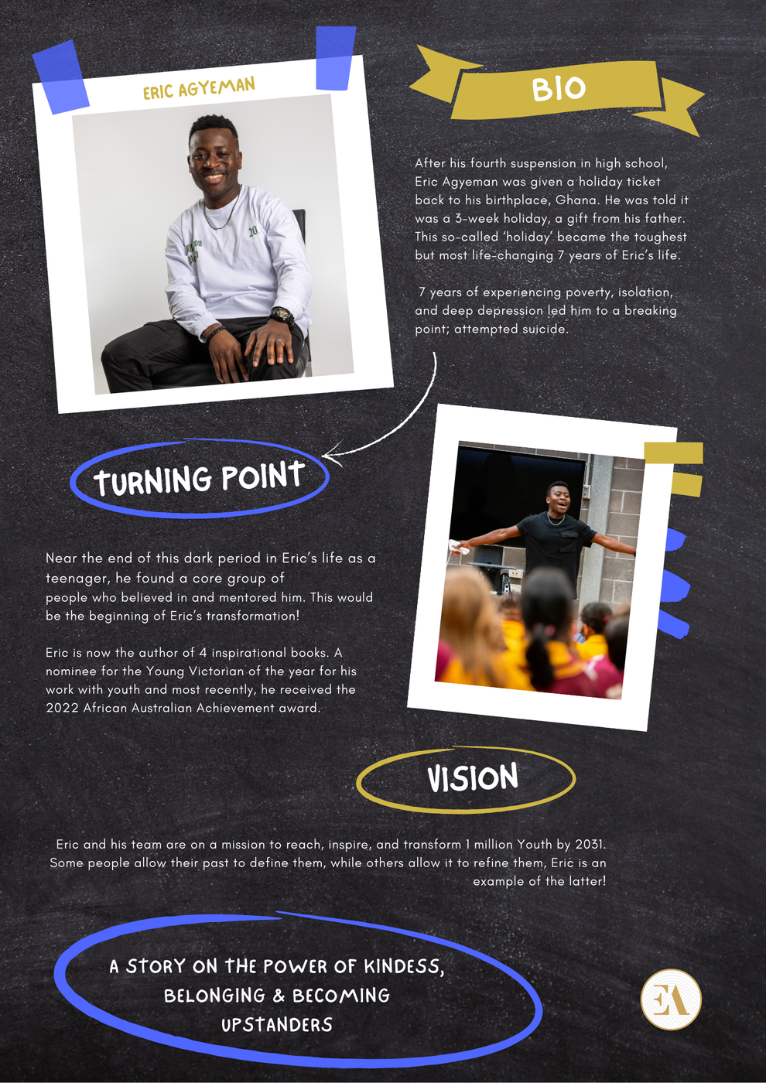
UPCOMING
GUEST
SPEAKER
Notes:
- Read some of the information off the slide to the class

Slide 7

Let’s Meet Eric!
Notes:
Click on the YouTube link to see a video from Eric

Slide 8
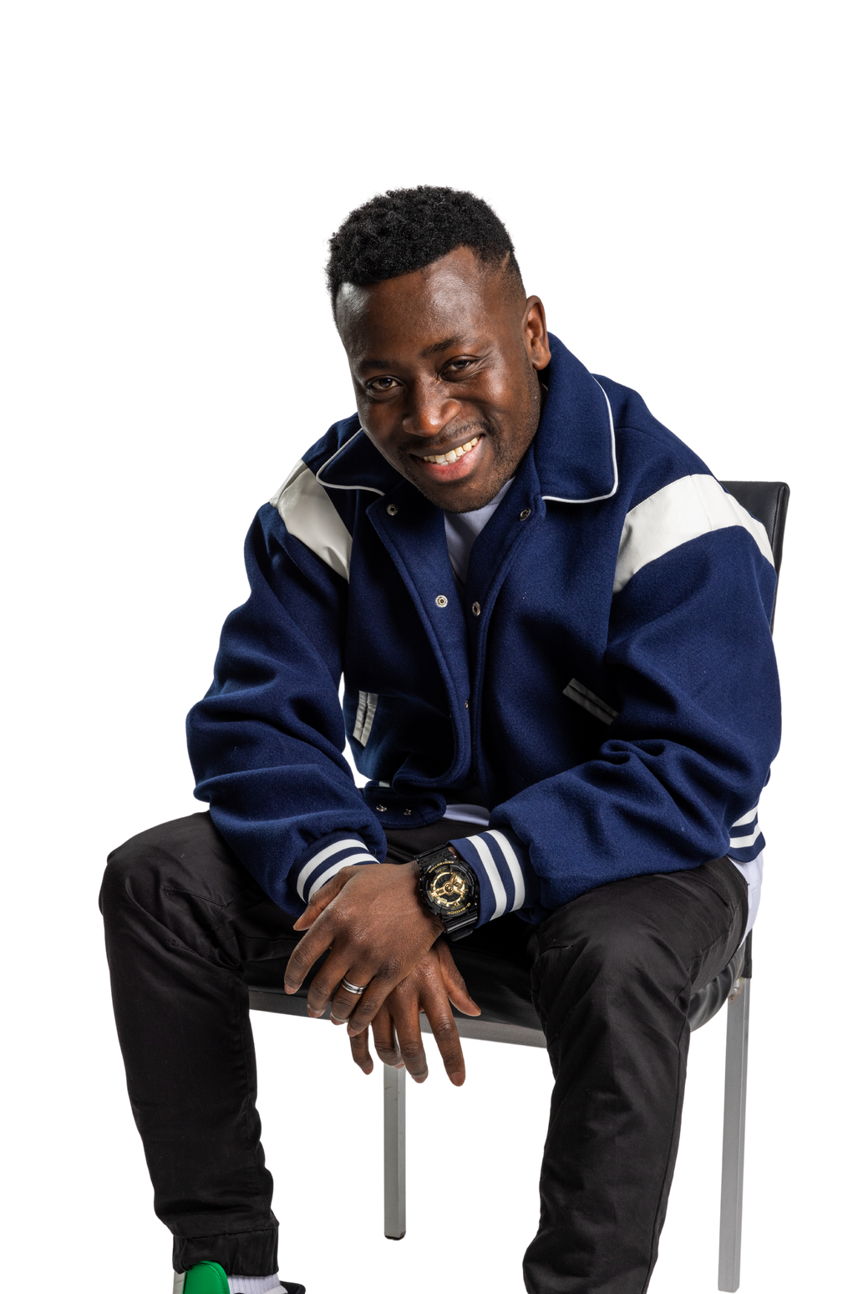

See You Soon ...
www.ericagyeman.com
Notes:
- End with another general conversation ...
How are the students feeling?
Would they like to share anything else?

