Slide 1

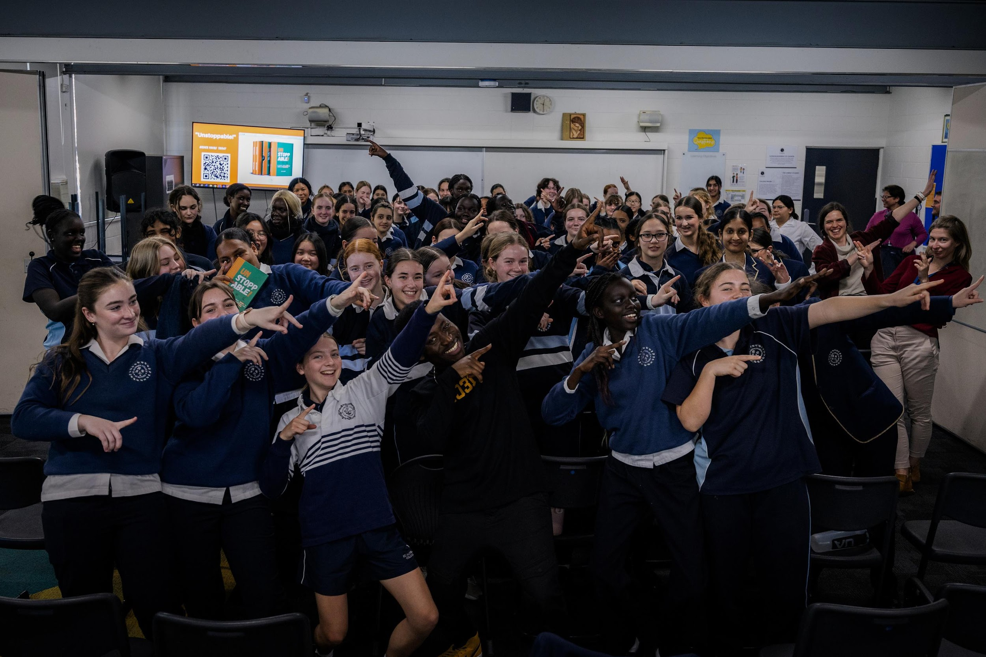

Eric Agyeman’s KEYNOTE
FOLLOW UP
Notes:
Eric Agyeman’s KEYNOTE
FOLLOW UP...
- Start with general conversation about what they thought?
- Ask a few students to share a highlight

Slide 2





Personal Reflection Time
Notes:
These activities are designed to reinforce the themes of Eric’s Keynote.
We will start with getting the students to reflect individually on topics raised in the Keynote.
The students will need to have something to write down personal answers on.

Slide 3

WRITE DOWN:
YOUR 1 KEY TAKEAWAY FROM ERIC’S KEYNOTE?
Notes:
Give the students a few minutes to write down their take aways
The 3 points from the Keynote they can use as a guide are:
- The power of words
- Failure is never a person, it’s only an event
- My future success!

Slide 4

Let’s SHARE:
  With the person next to you
  To the Group
Notes:
- Get the students to discuss / share their take aways with the person next to them (or small groups of 3) if they feel comfortable
- After 5 mins or so, ask if anyone would like to share with the whole group

Slide 5
WRITE DOWN:
IN WHAT AREA(S) SPECIFICALLY WILL YOU IMPLEMENT THIS TAKE AWAY?
Notes:
Get the students to write down their answer individually

Slide 6
Let’s SHARE:
  With the person next to you
  To the Group
Notes:
- Get the students to discuss / share their take aways with the person next to them (or small groups of 3) if they feel comfortable
- After 5 mins or so, ask if anyone would like to share with the whole group

Slide 7

WRITE DOWN:
Based on Eric‘s 3rd point;
“My Future Success ...”
What is the biggest dream, goal or aspiration you have for your future?
Notes:
Get students to write down their answer individually

Slide 8
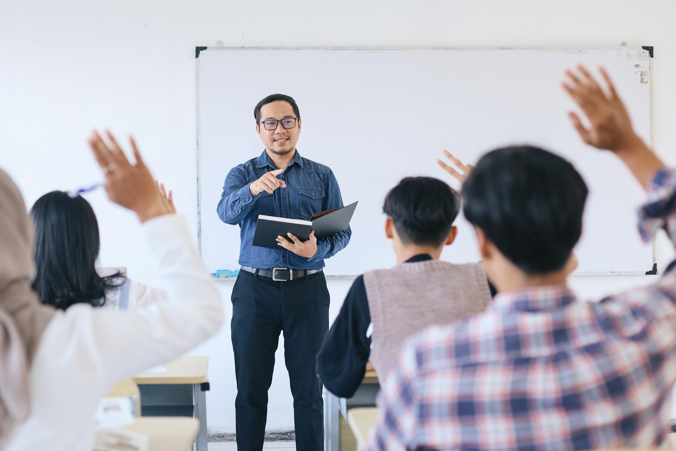
Let’s SHARE:
  Would anyone like to share with the Group?
Notes:
- Get the students to discuss / share their take aways with the person next to them (or small groups of 3) if they feel comfortable
- After 5 mins or so, ask if anyone would like to share with the whole group

Slide 9
WRITE DOWN:
Based on Eric‘s 3rd point; “My Future Success ...”
What are 2 personal affirmations to write down and repeat daily to help you believe in yourself and your future dream and goal!
eg ‘I am worthy of....’
Notes:
Individually

Slide 10

LET’S PRACTISE ...
Notes:
- See if anyone would like to share theirs
- It can be fun to chant some as a group where they repeat after you...

Slide 11
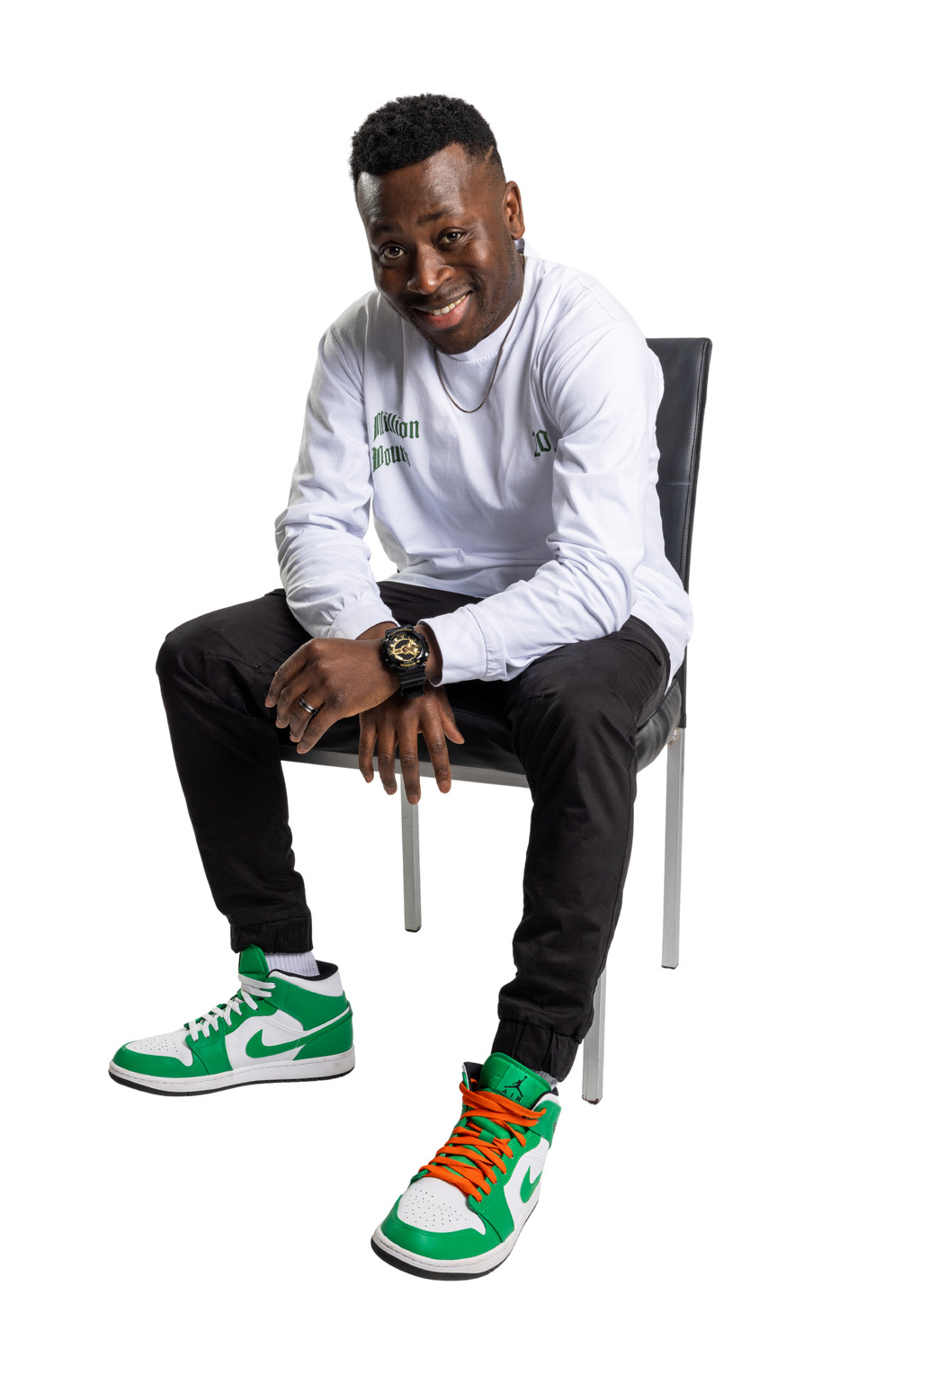

Until next time ....
www.ericagyeman.com
Notes:
- End with another general conversation ...
How are the students feeling?
Would they like to share anything else?

