Slide 1

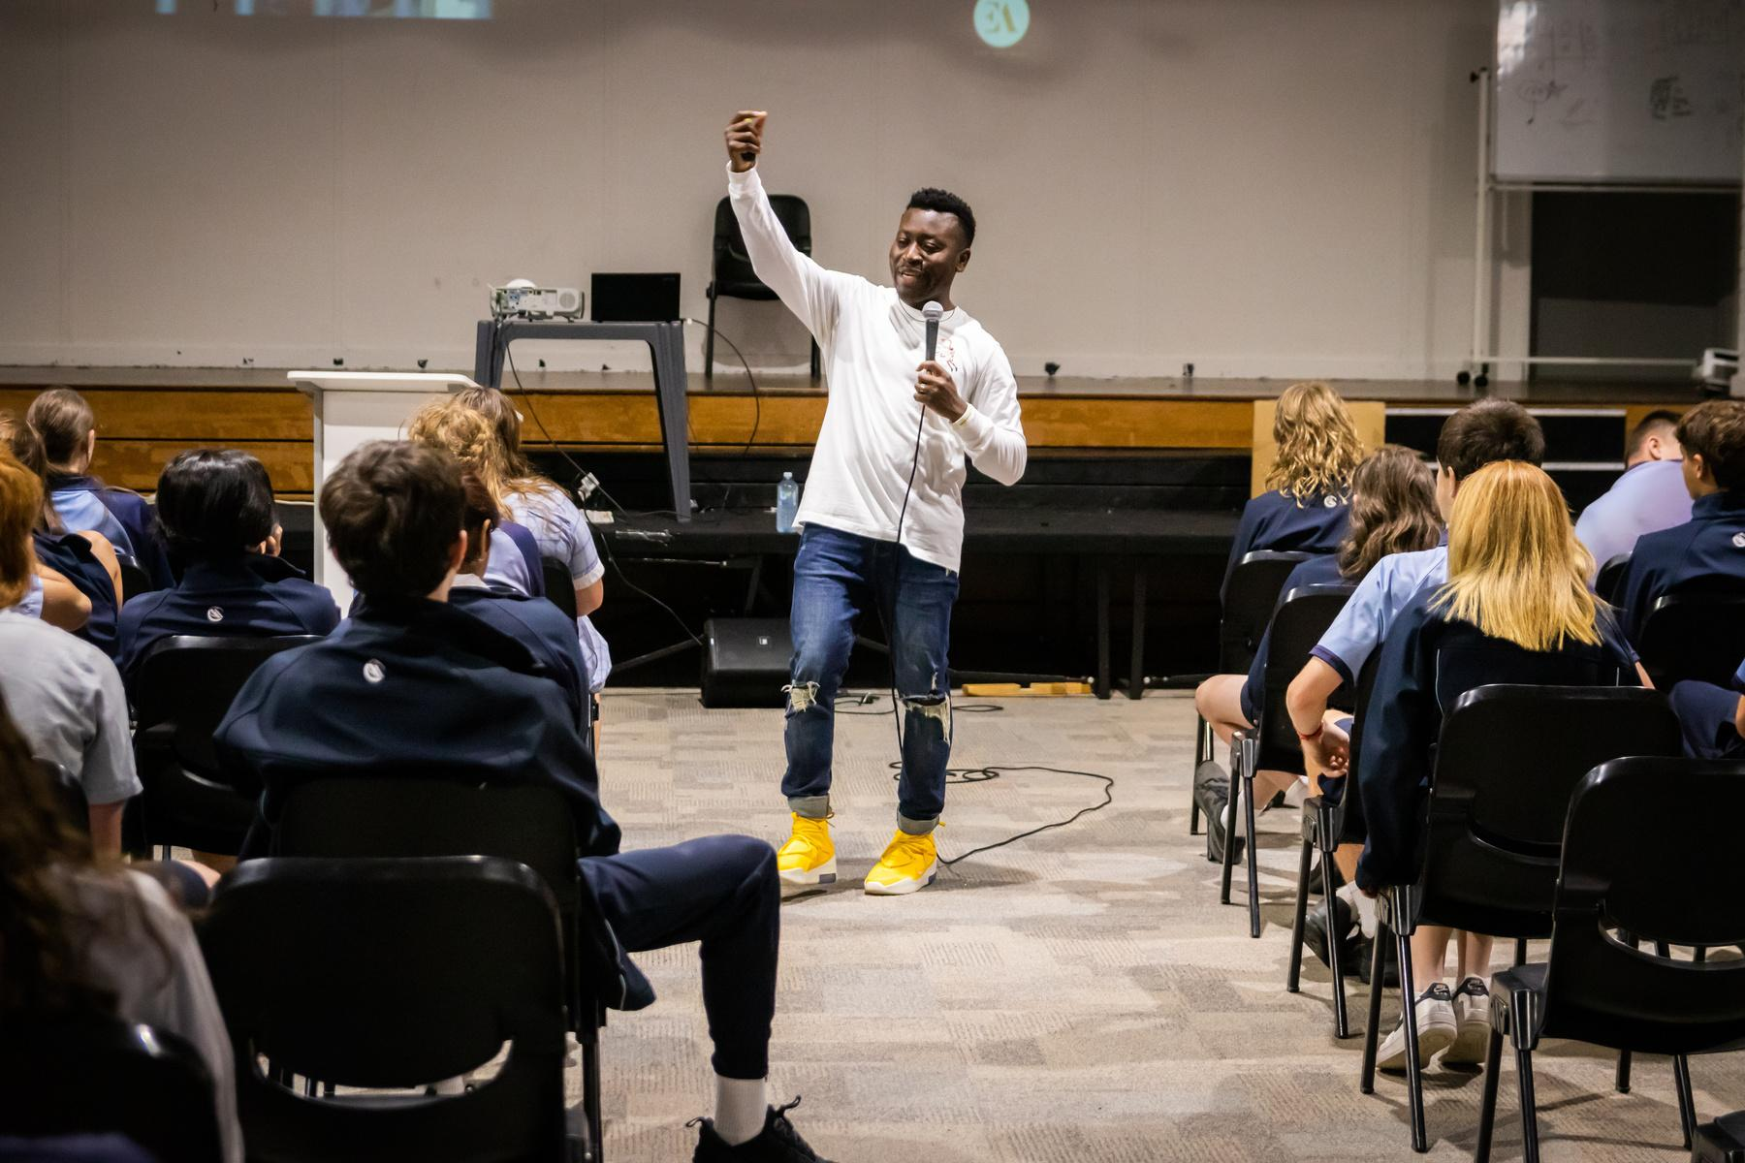

Eric Agyeman’s I BELONG Workshop
FOLLOW UP
Notes:
These slides are designed to reinforce and practice the Upstanders concepts Eric spoke about.
They will also continue building upon the foundation of The Power Of Words to improve well-being and a culture of belonging among your students by putting the positive side (SEEDS) into practice.

Slide 2
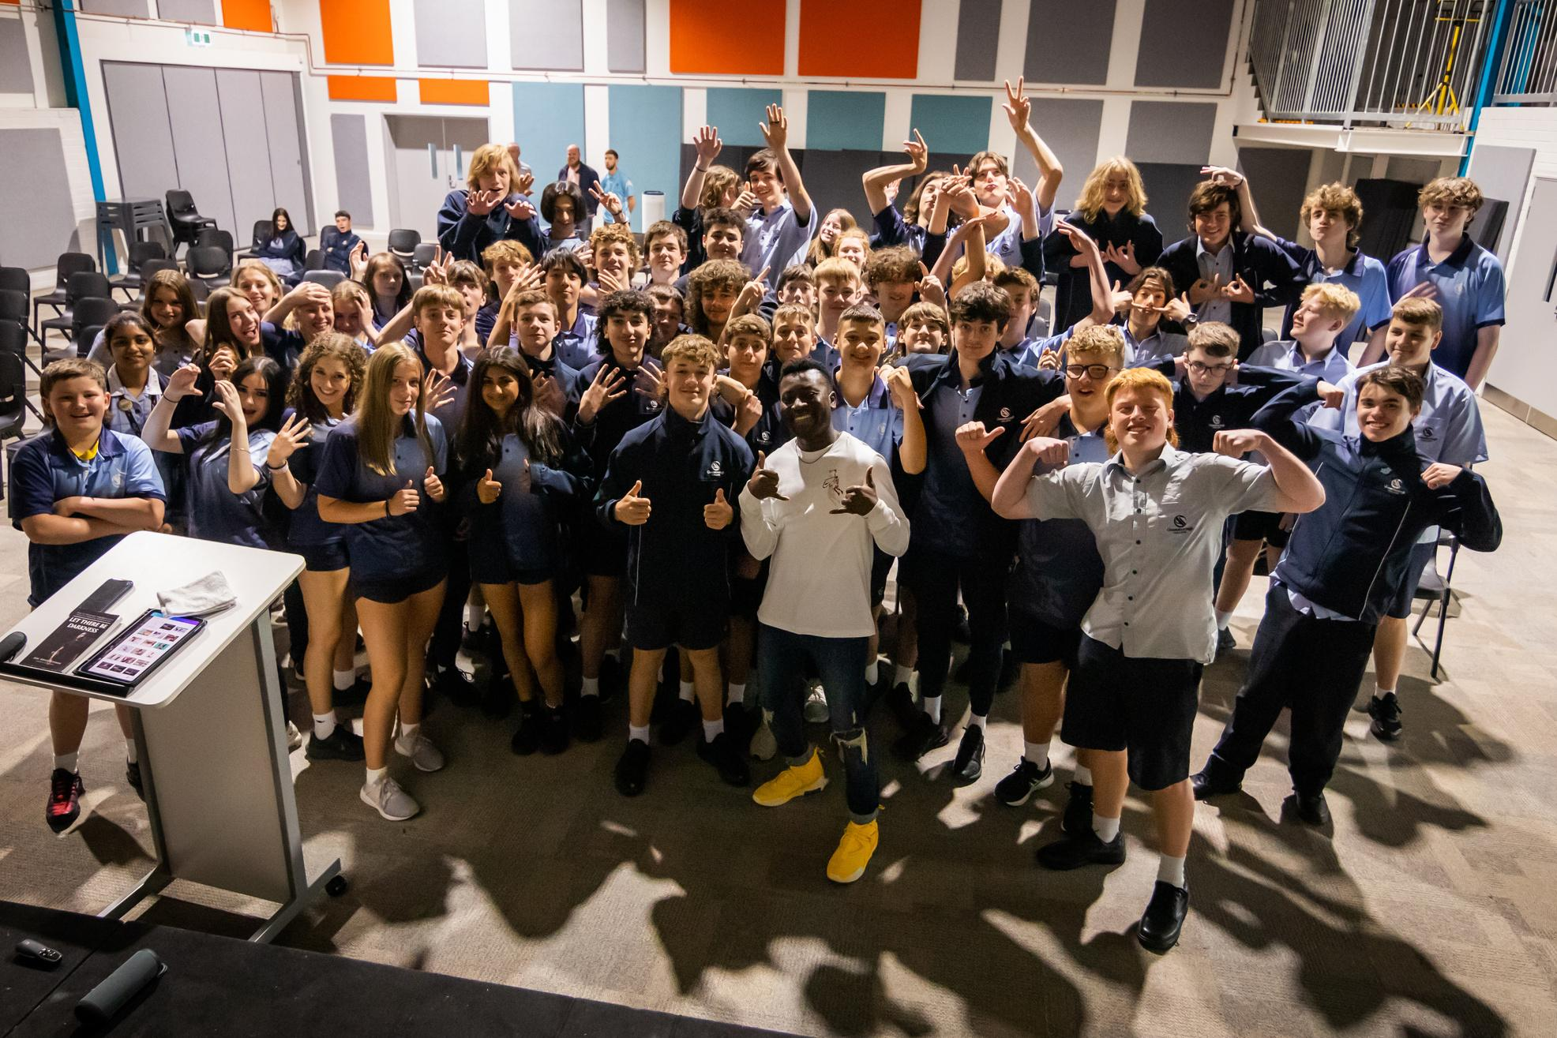
iBELONG
CREATING A SCHOOL CULTURE OF KINDNESS

Slide 3




Upstander Scenario Questions &
Reflection Time
Notes:
Group Activity 1 ....

Slide 4
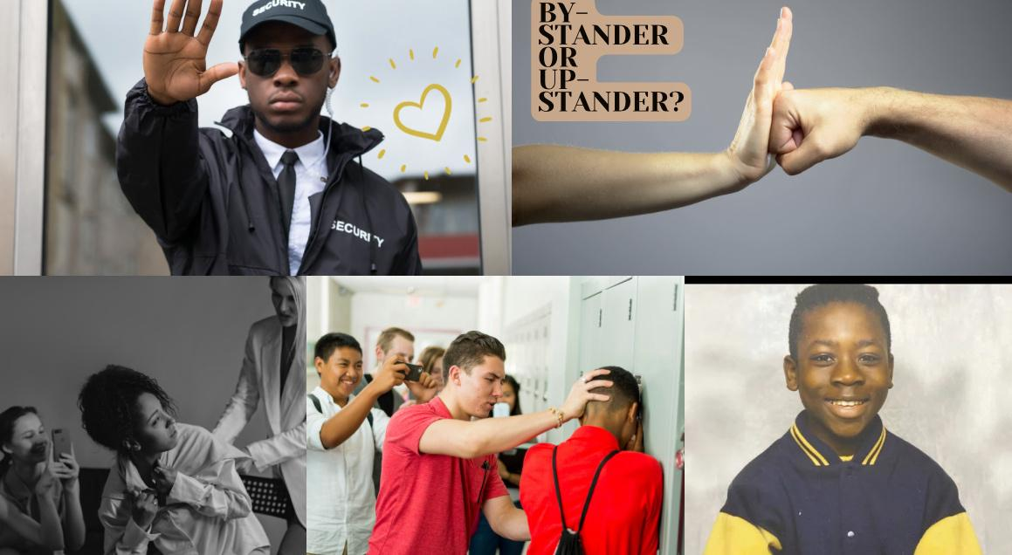
Notes:
Let's think about the type of people we want to be ...
Upstanders or Bystanders ...

Slide 5
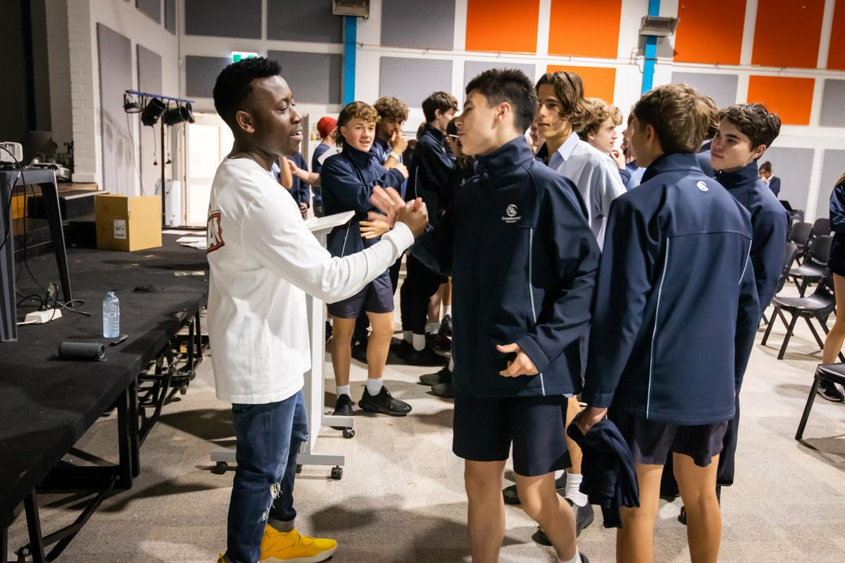
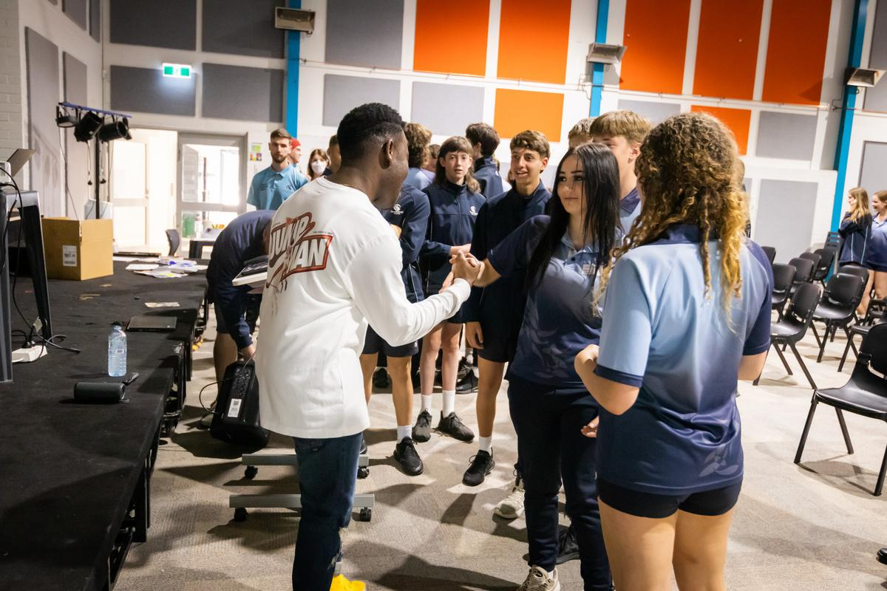
  Becoming The Upstander Your Friends Need!
Notes:
Split the group into small groups of about 6-10 people.
Assign each group one scenario. More than one group may have the same scenario.

Slide 6

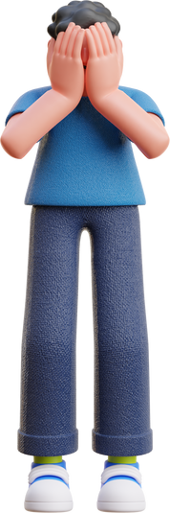
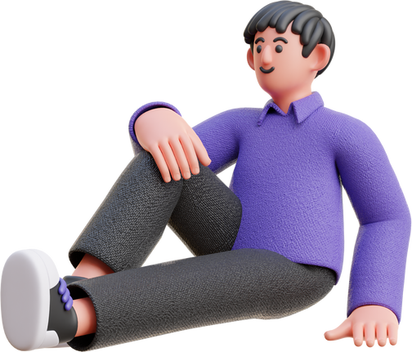

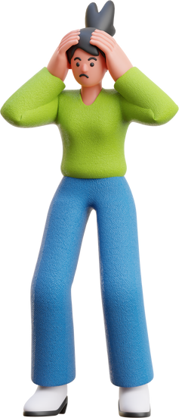
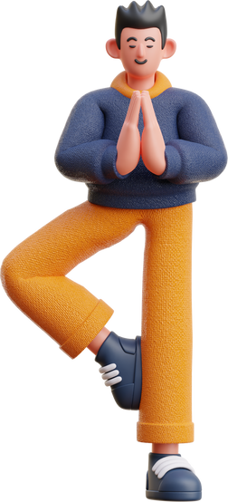
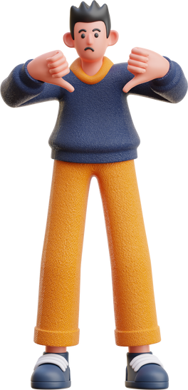
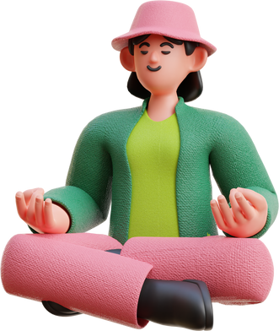
  Scenario Questions
  Reflection Questions
A student is being teased for wearing glasses and is called names like "four-eyes" by their classmates
How might the person being bullied feel if no one stands up for them?
A group of students is spreading rumors about a classmate's sexual orientation, leading to exclusion and bullying
What are some strategies you could use to support the victim and address the behavior of the aggressors?
A student is being cyberbullied on social media, and hurtful comments are spreading rapidly
What are the potential consequences of not intervening in these situations?
Notes:
The students should brainstorm as a group and write down thoughts to share

Slide 7
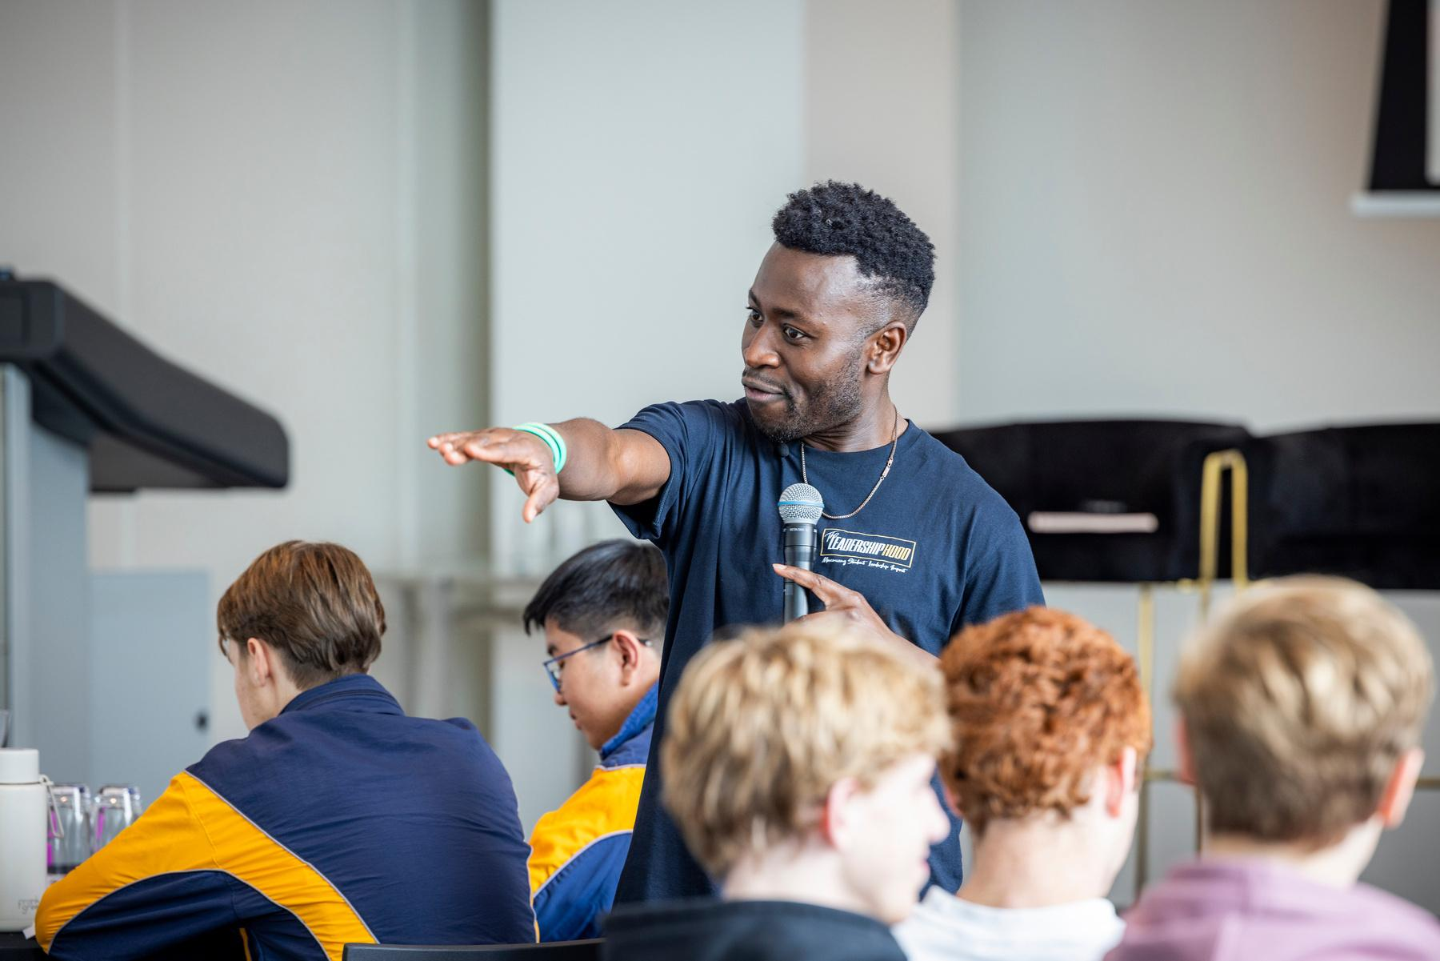
Let’s Share ...
Notes:
Get each group to share their scenario & how they responded.

Slide 8
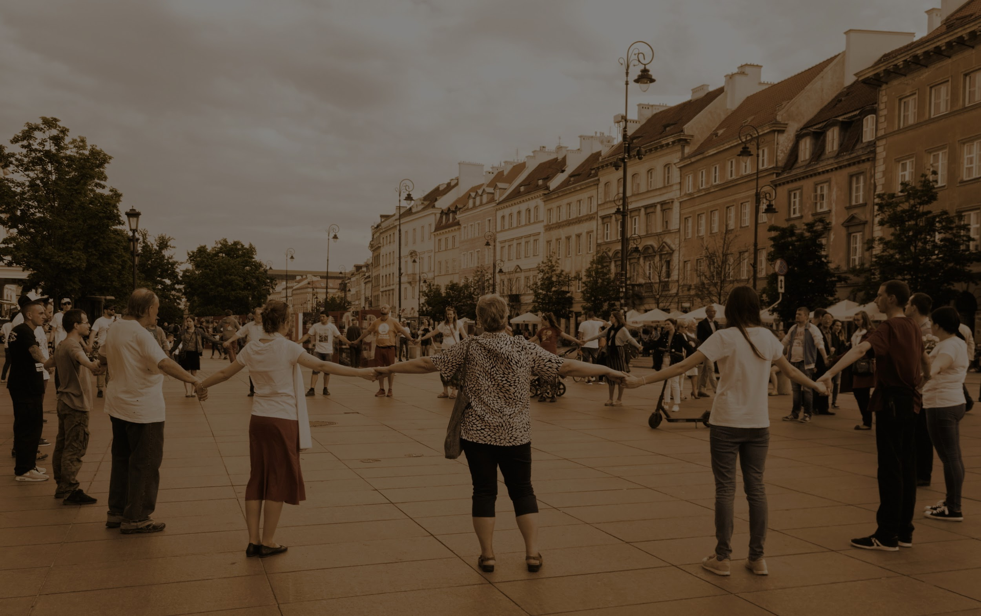
Affirmation
Circle
Notes:
Group Activity 2 ...
Break up into small groups of 6-10 students (can be the same as inactivity 1).
- Form a circle and have 1 person in the middle of a circle.
- The person is to keep turning to their peers. Each person in the circle says something short and meaningful to their peer in the middle of the circle.
This is reinforcing the power of positive words (seeds) to brighten someone's day and create a belonging environment
- Keep swapping the person in the middle until everyone has had a turn

Slide 9
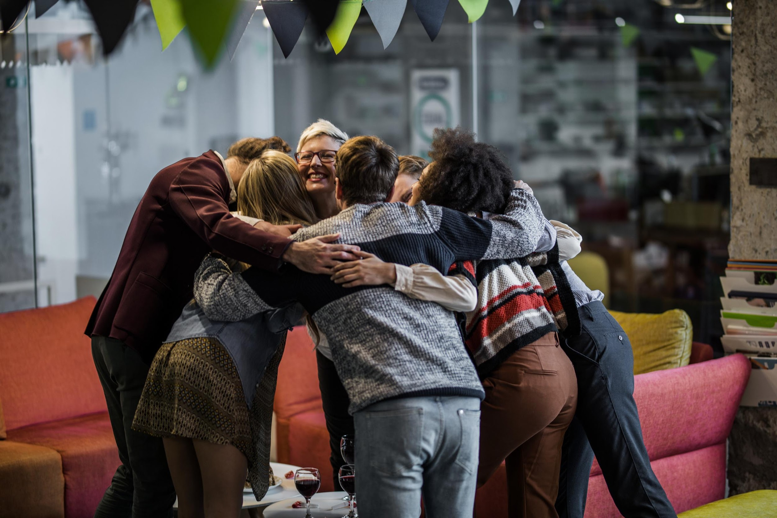
iBELONG
Notes:
Ask for any feedback about how that felt.
Reinforce that it is ok if it was foreign at first.
Encourage them to continue to speak positive works over their friends and family.

Slide 10
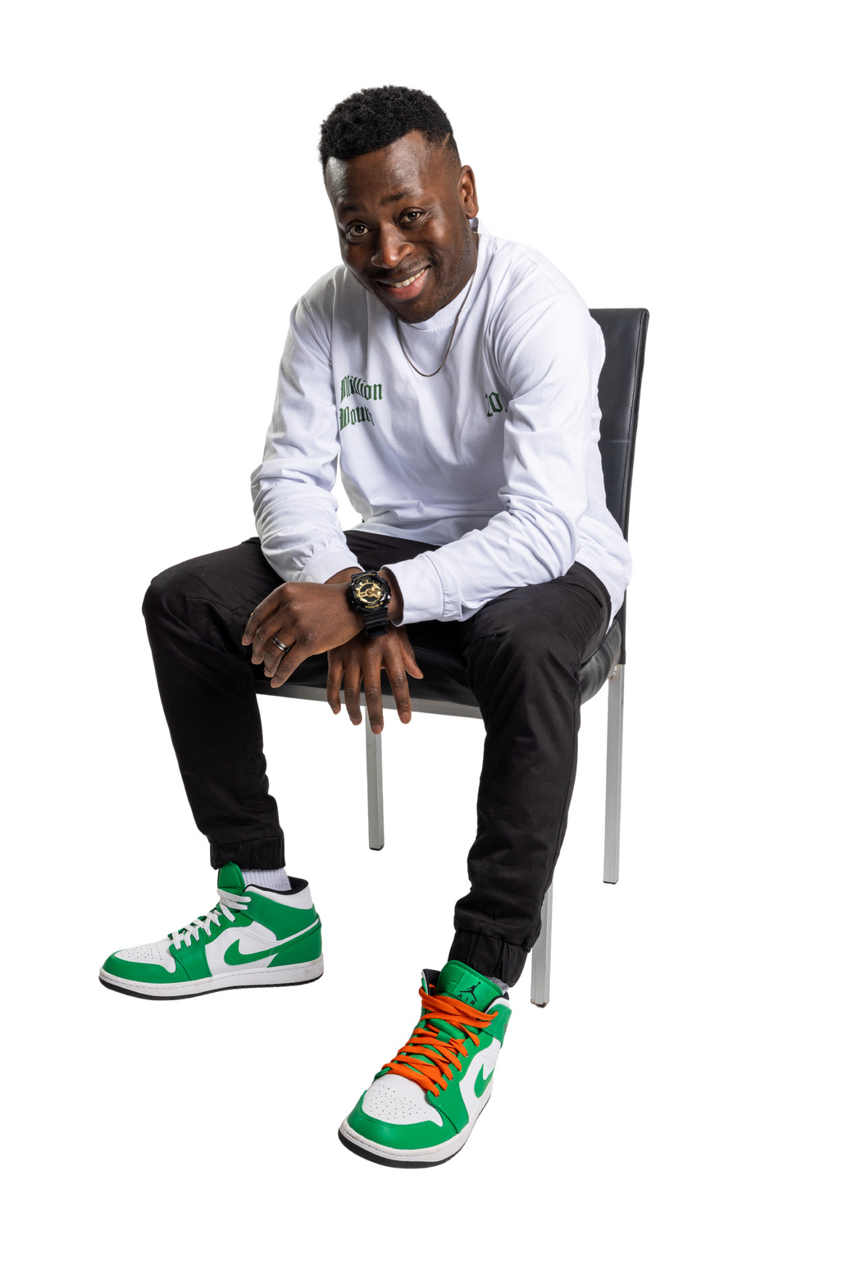

Until next time ....
www.ericagyeman.com

